Slide 1


TEAM – 2 ParkEz
Team Members:
Krunal Bhavsar
Tom Cookson
Tom Alex
Shubham Mittal
Swayambhu Dhuri
Ruchi Sharma
Suruchi Patil
Srija Reddy
Chetan Besnat

Slide 2
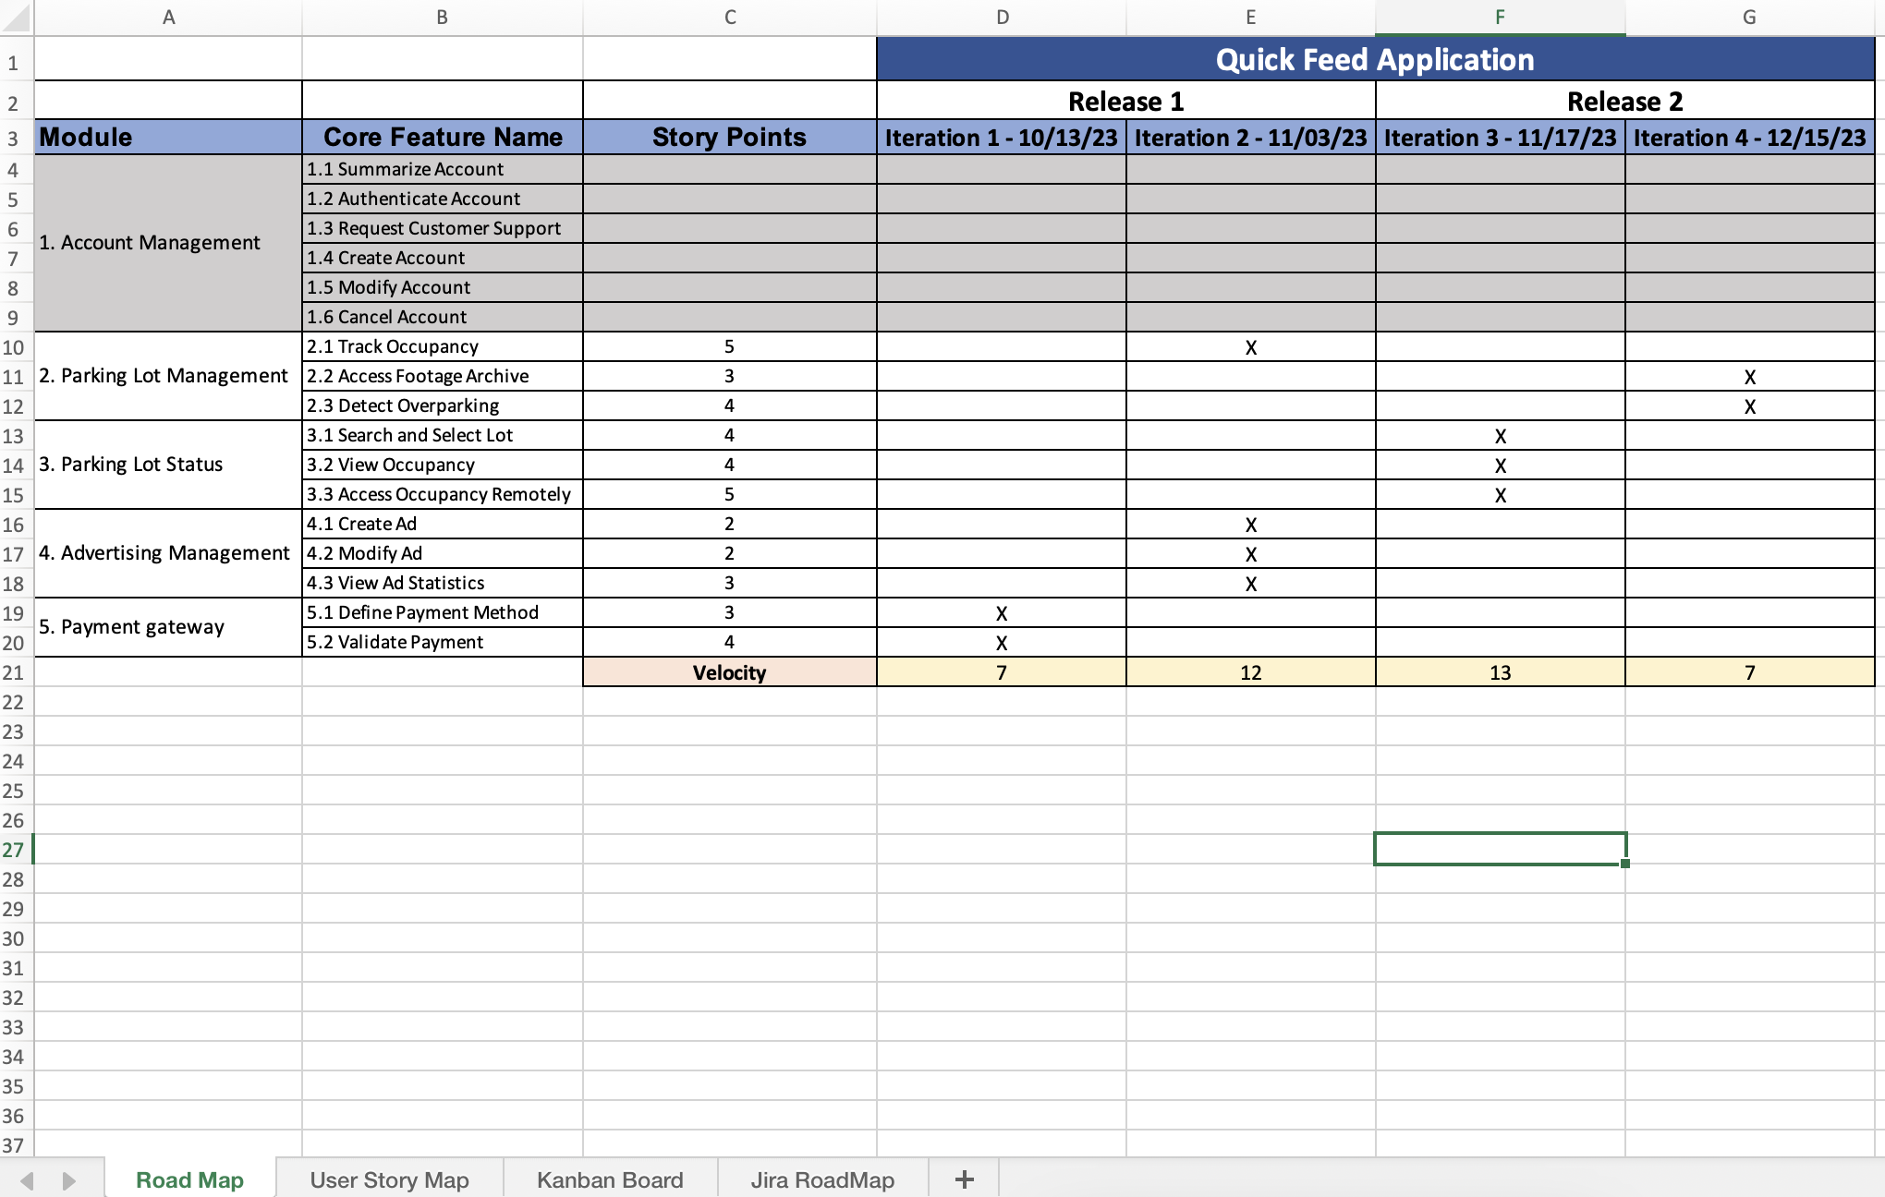
Road Map and User Story: Tom Alex

Slide 3
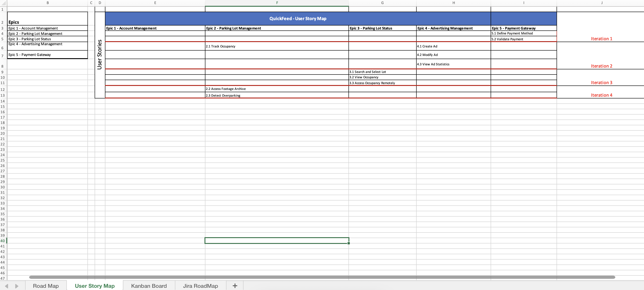

Slide 4
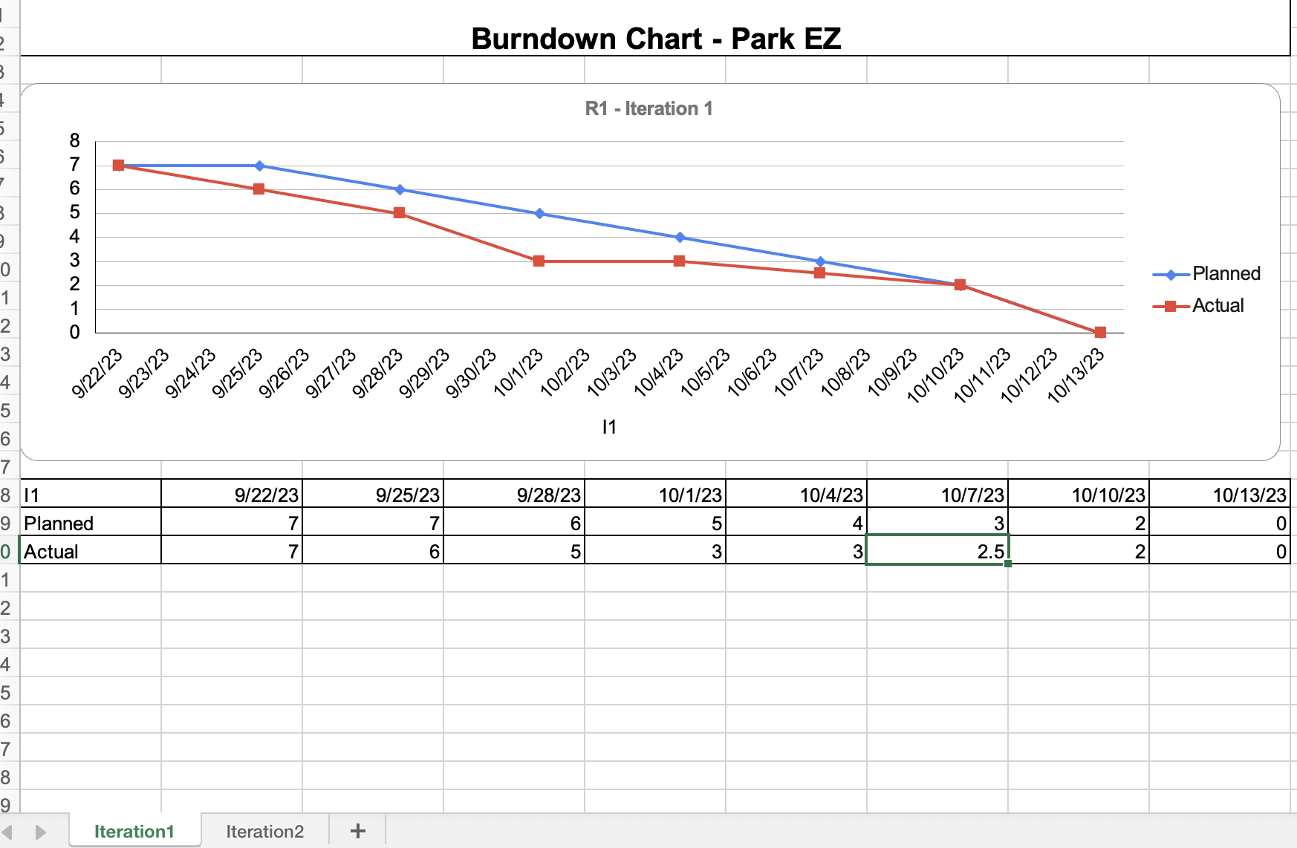
Burnt-down Chart: Krunal Bhavsar

Slide 5
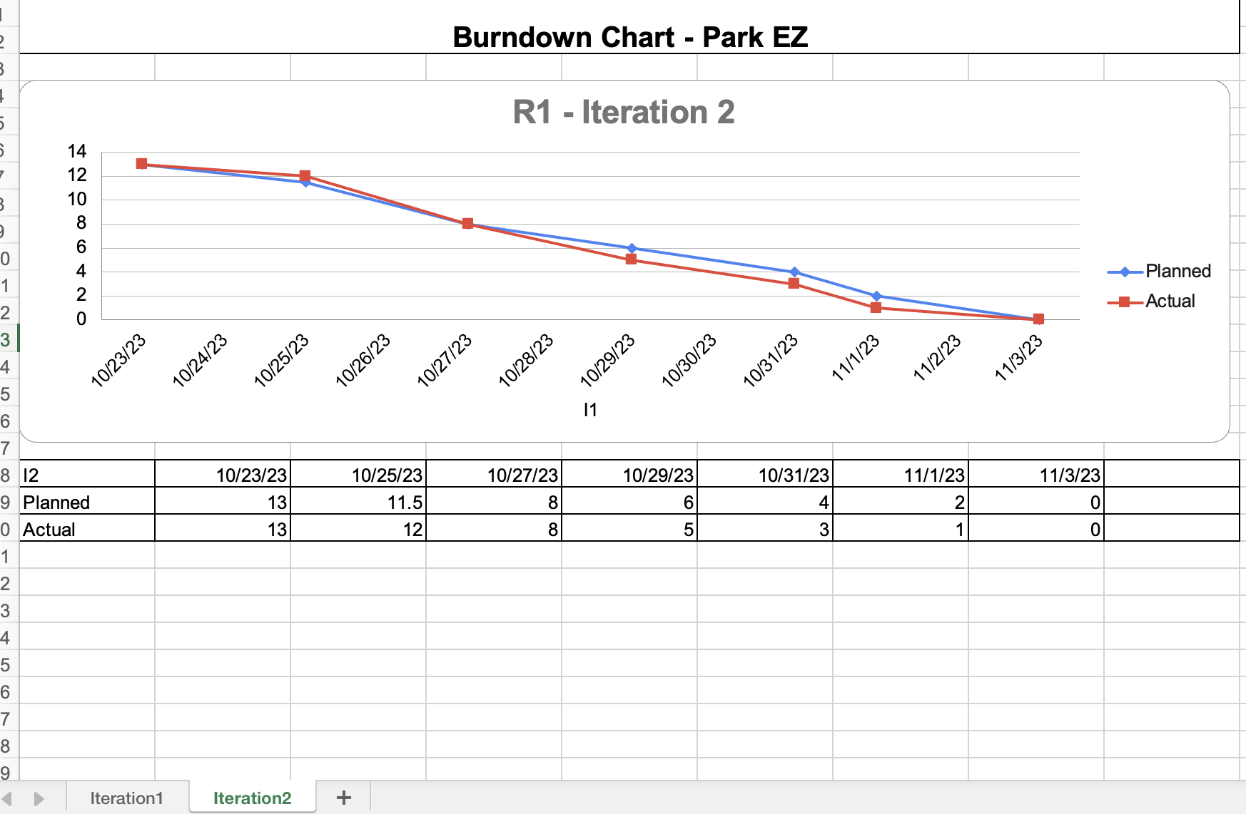

Slide 6
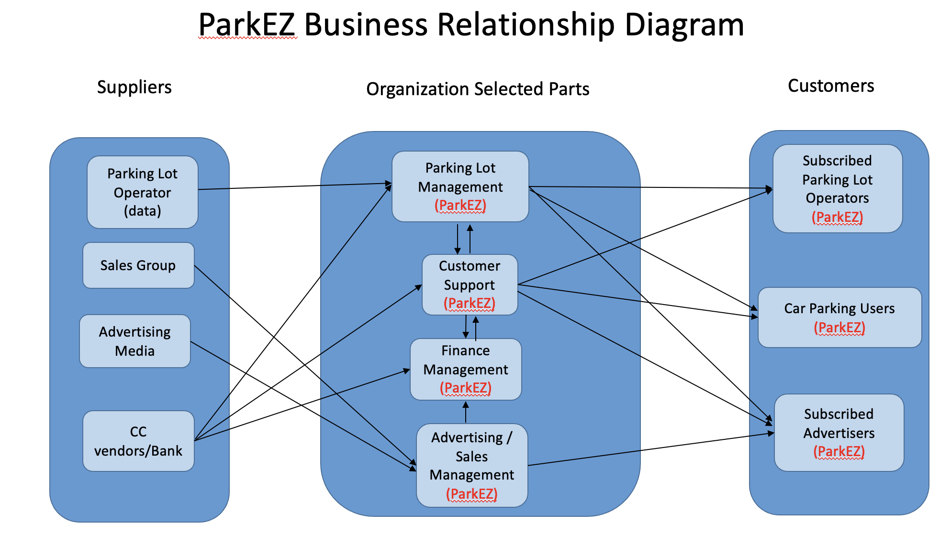
BRM: Chetan Besnat

Slide 7
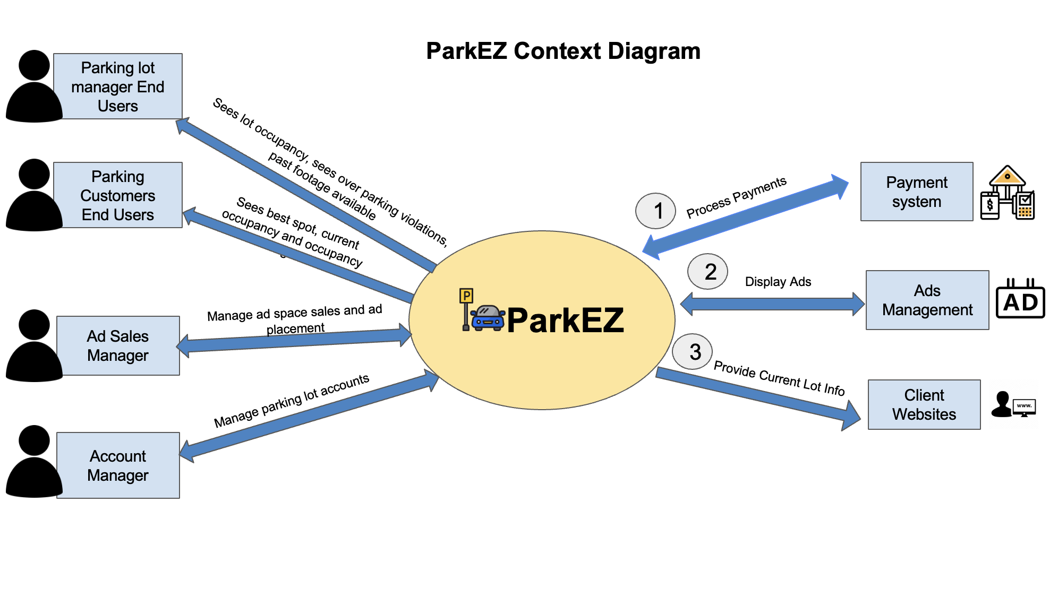
Context Diagram: Suruchi Patil

Slide 8
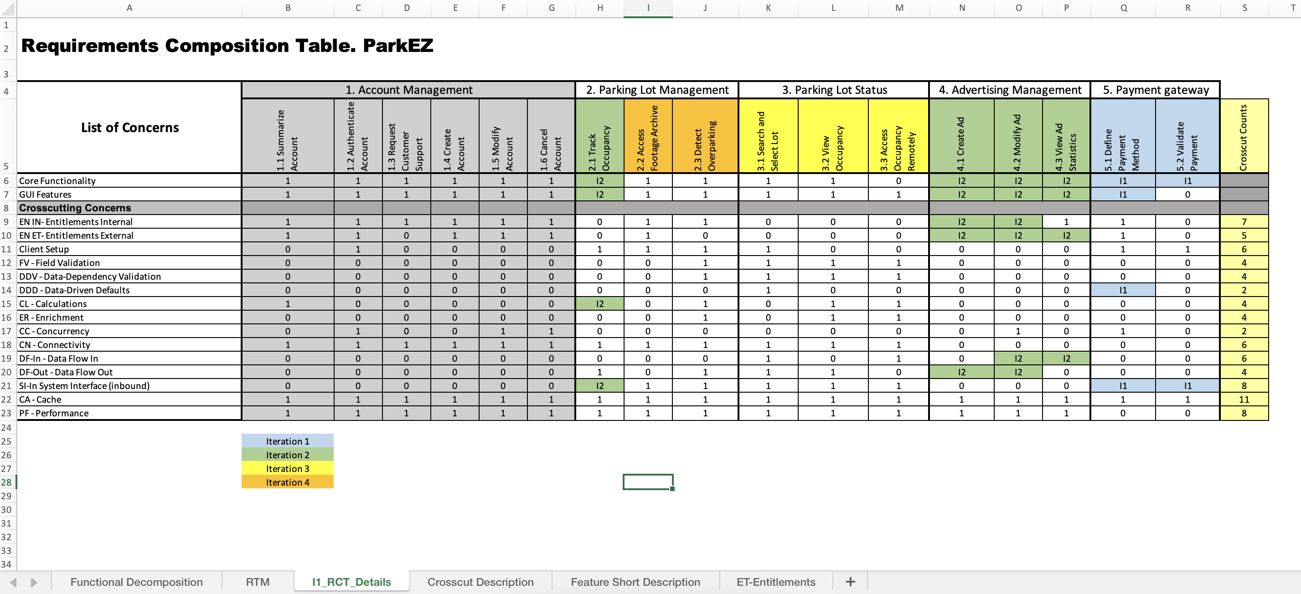
RCT: Shubham Mittal

Slide 9
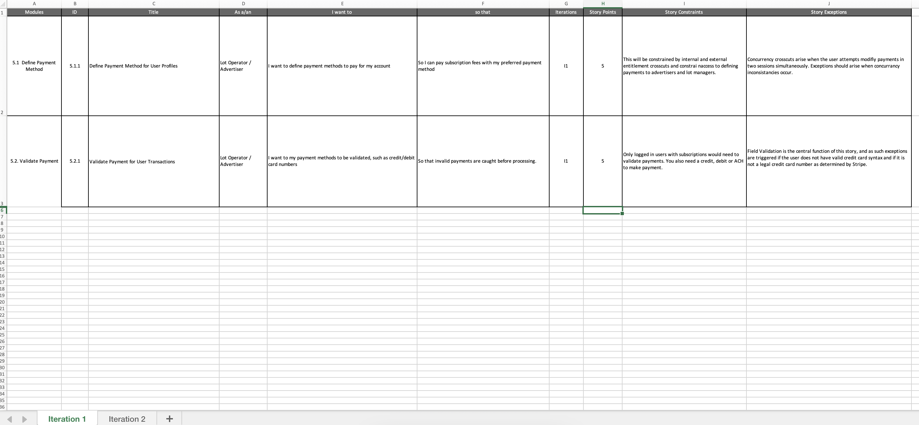
User Stories: Ruchi Sharma

Slide 10
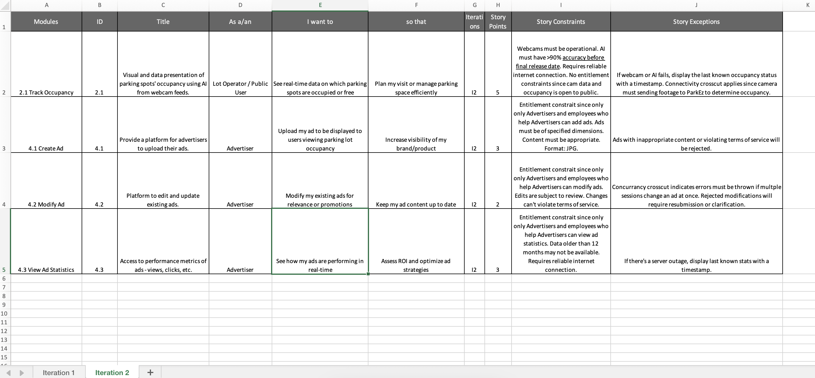

Slide 11
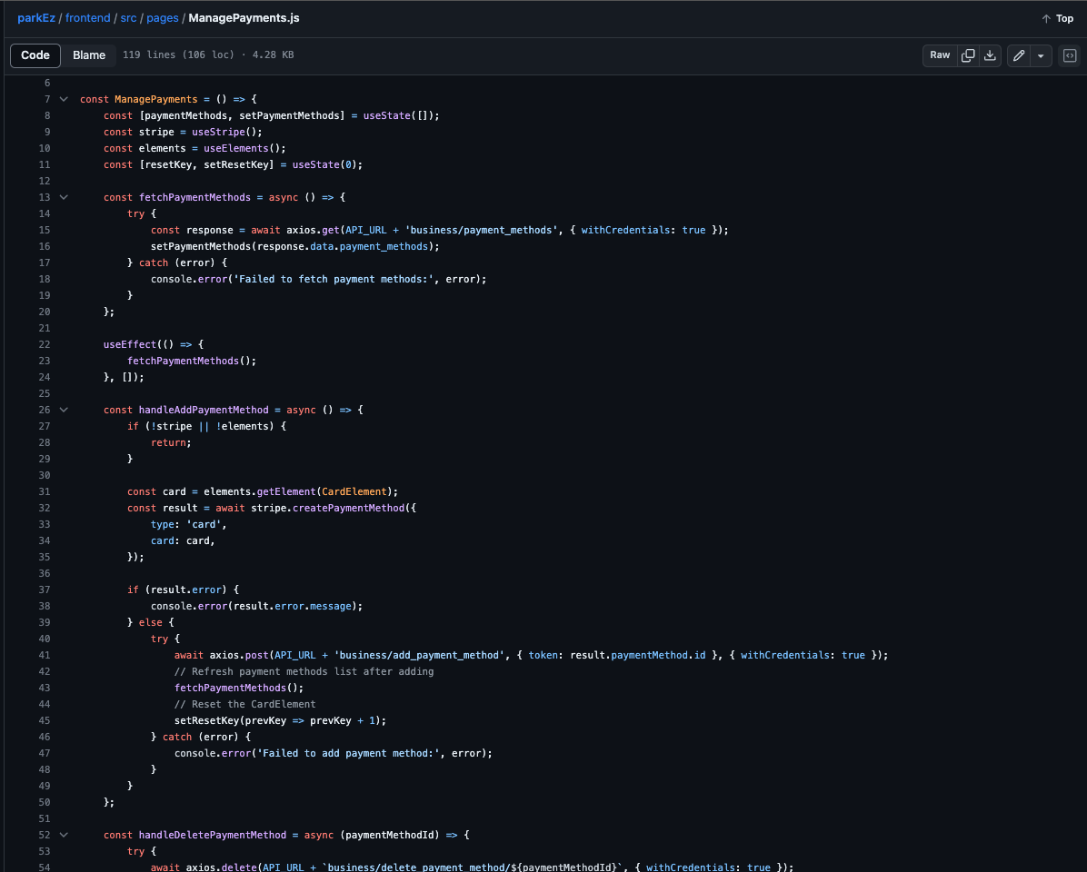
Source Code – Swayambhu Dhuri

Slide 12
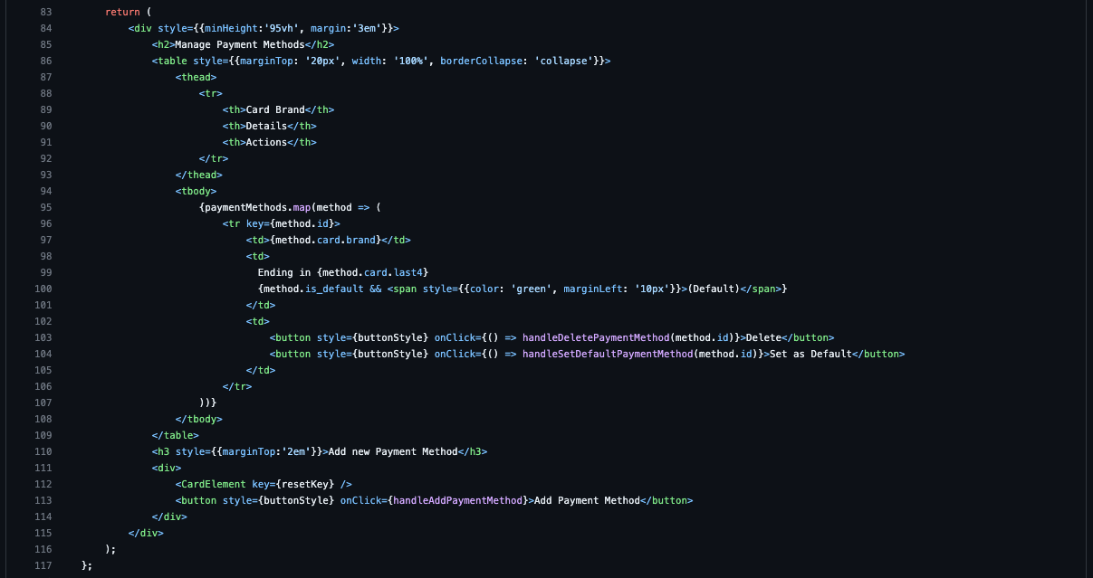
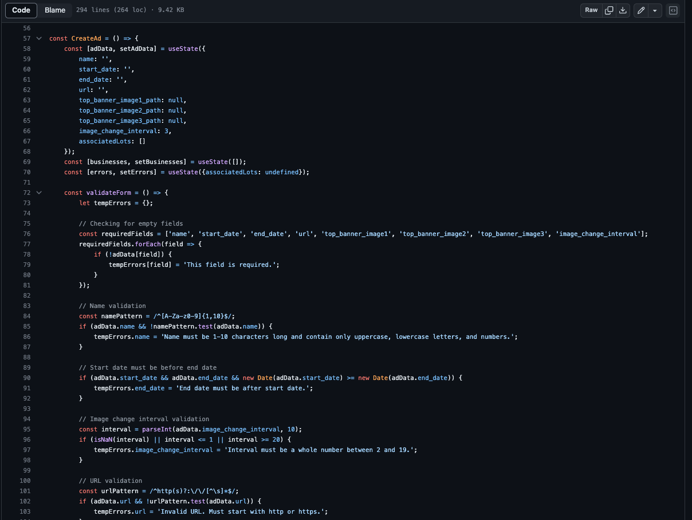

Slide 13
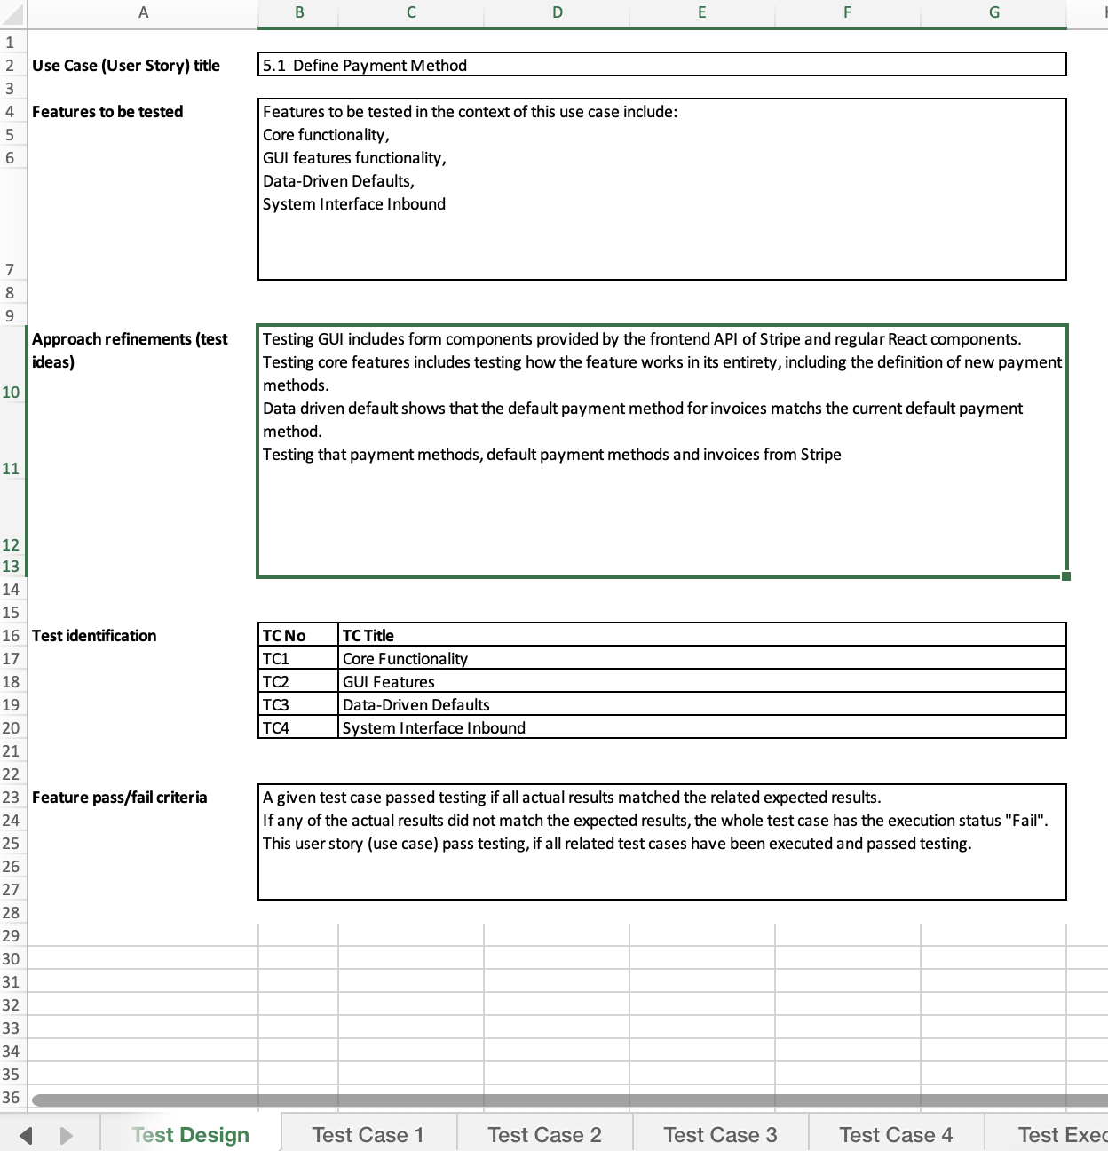
Acceptance Test I1 – Tom Cookson

Slide 14
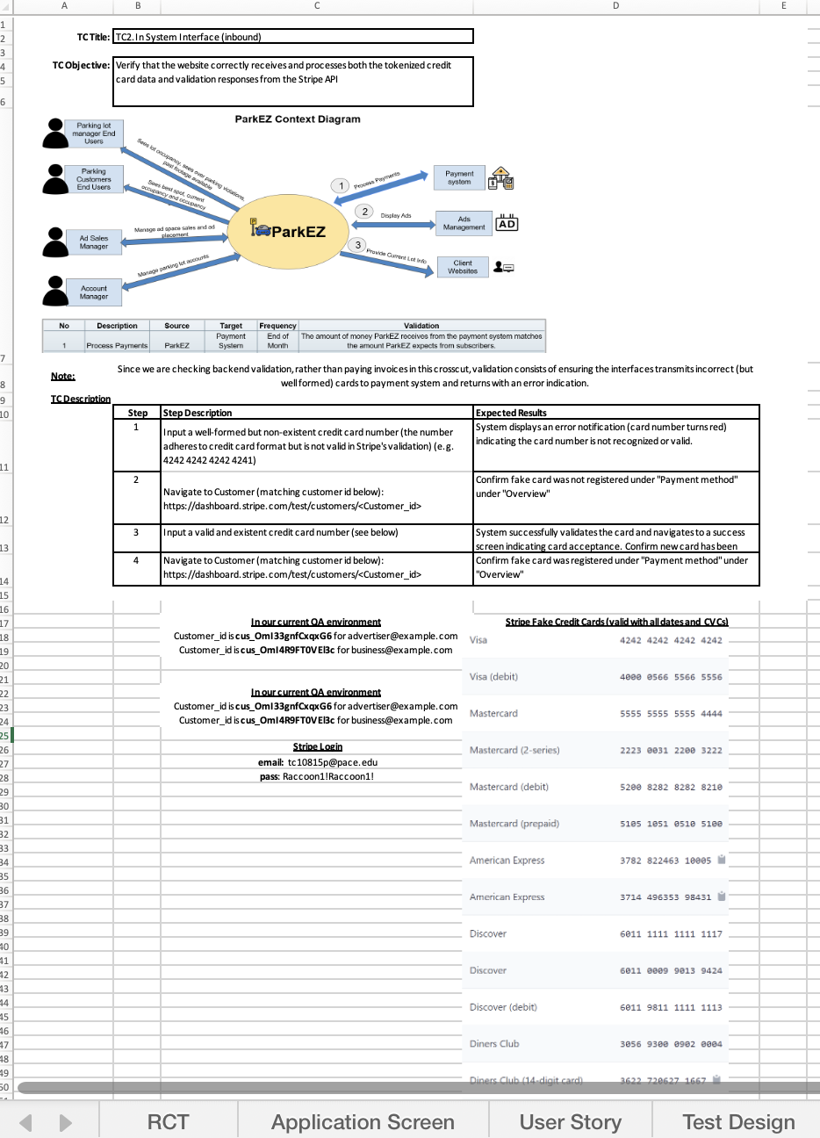

Slide 15
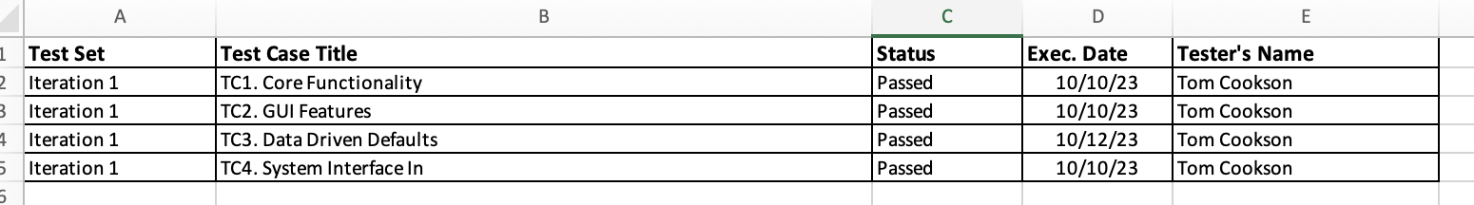
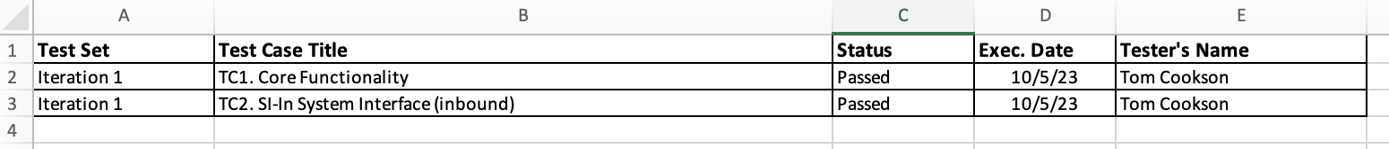
Test Execution Log – I1 Tom Cookson

Slide 16
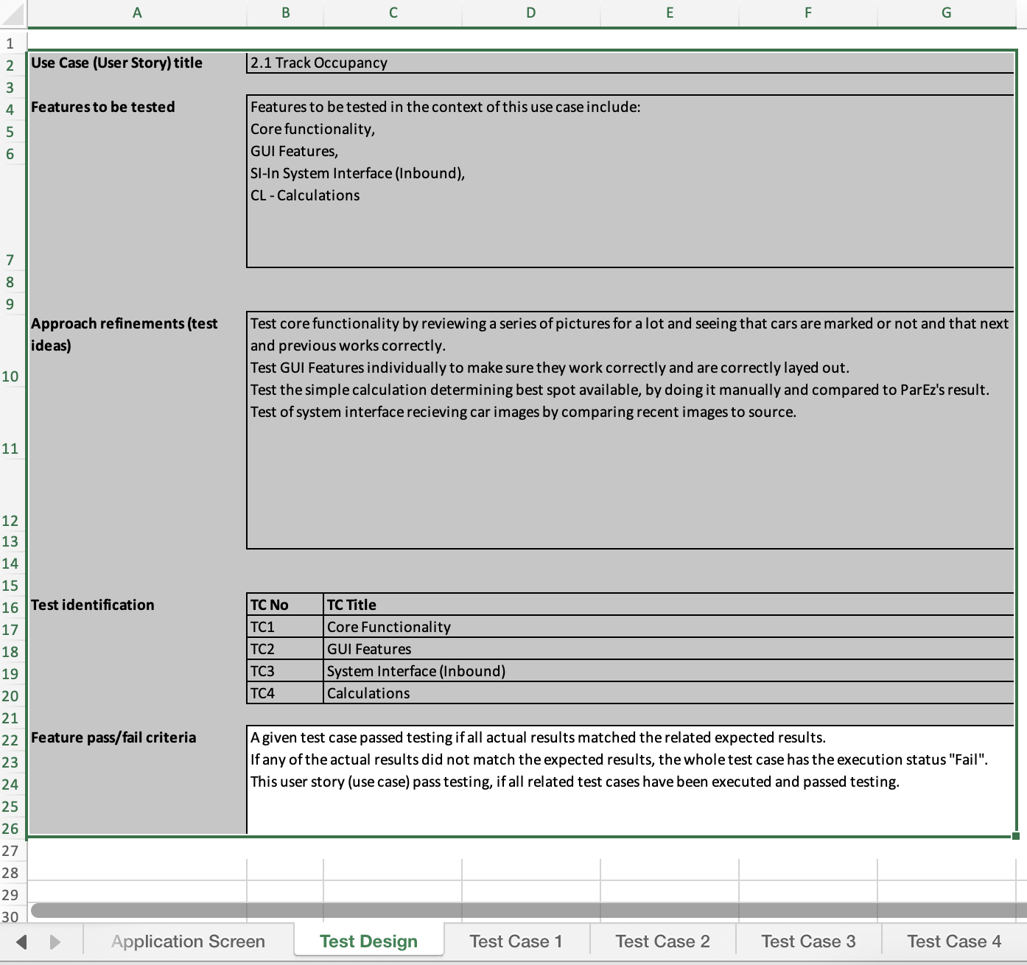
Acceptance Test I2 – Tom Cookson

Slide 17
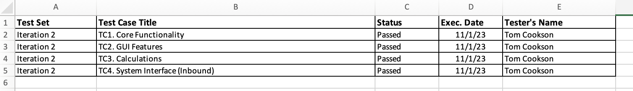
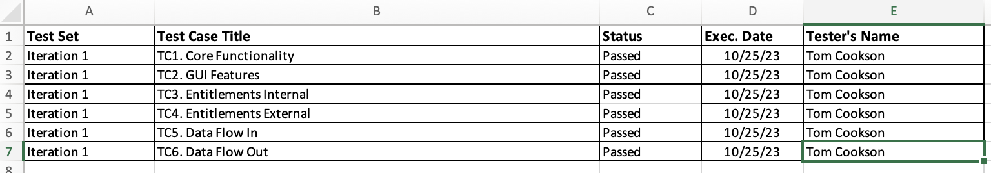
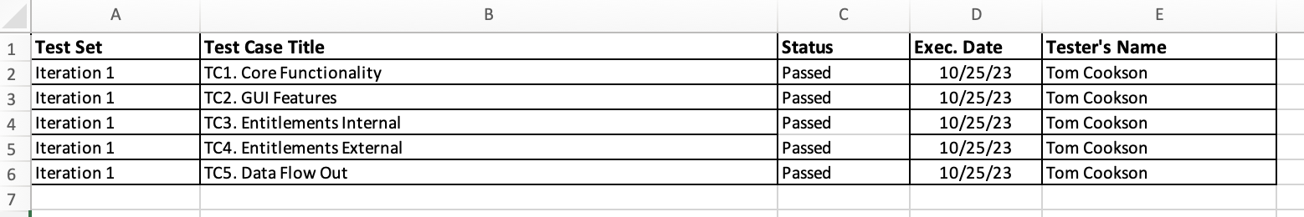
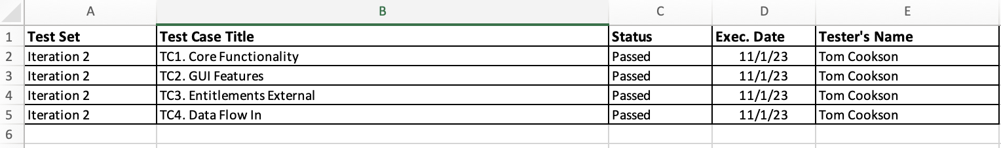
Test Execution Log – I2 Tom Cookson

Slide 18
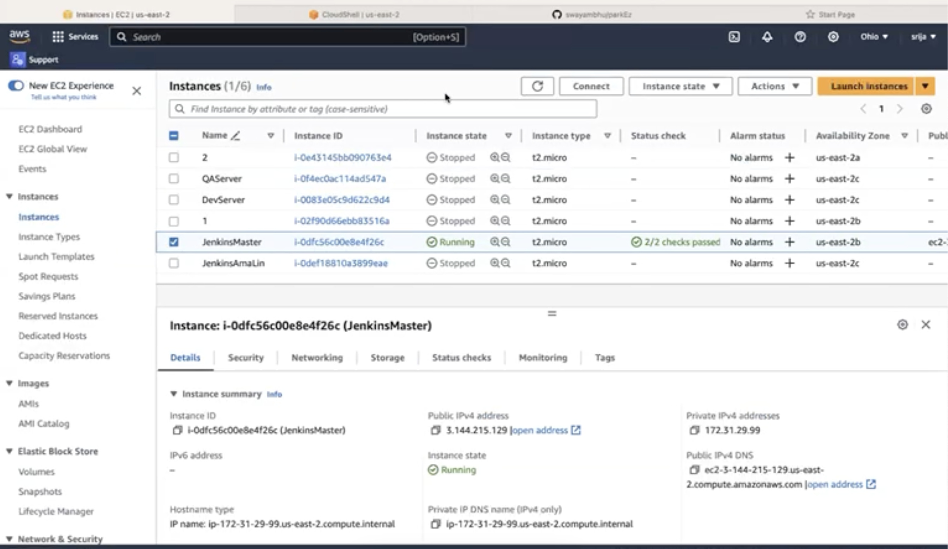
Jenkins DEMO: Srija Reddy

Slide 19
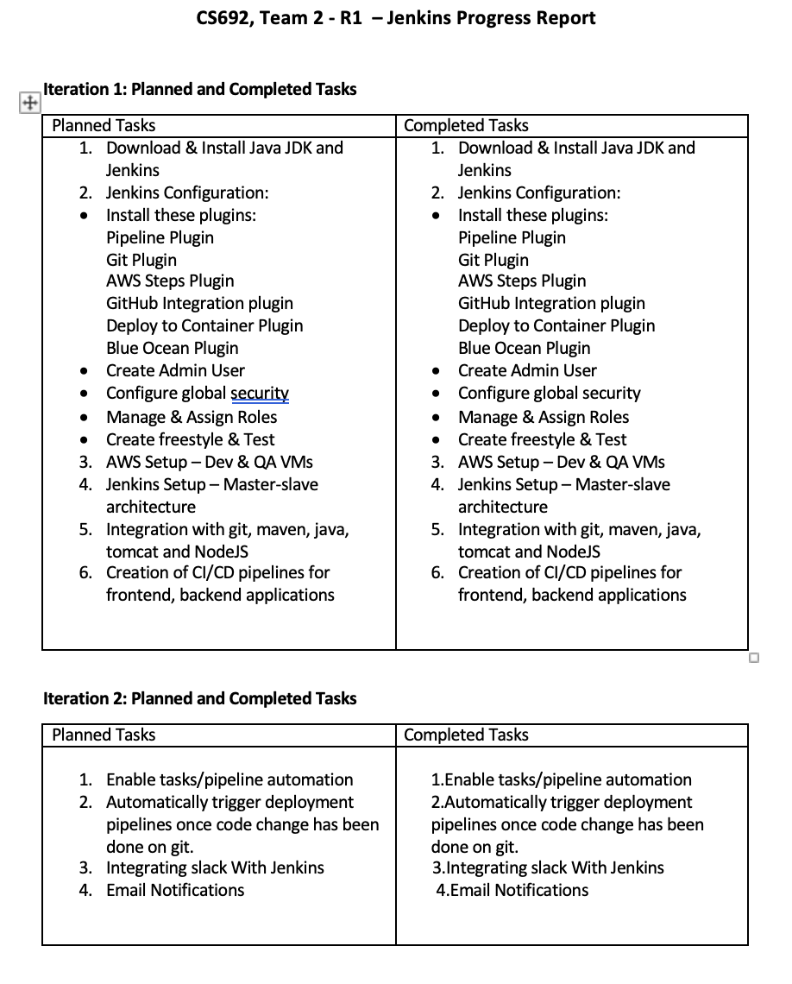
Jenkins Progress Report: Srija Reddy

Slide 20
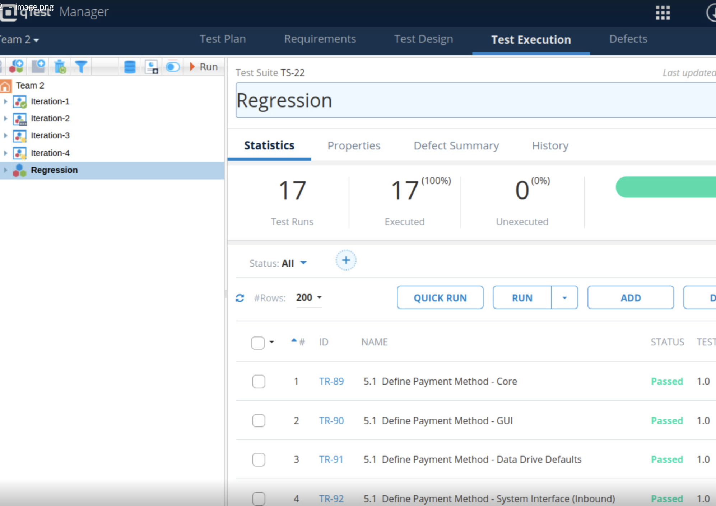
Q-TEST: Tom Cookson

Slide 21



GitHub Repo structure
R1 Documents
Machine Learning
backend
Frontend
Docker-compose.yaml
Jenkinsfile

Slide 22
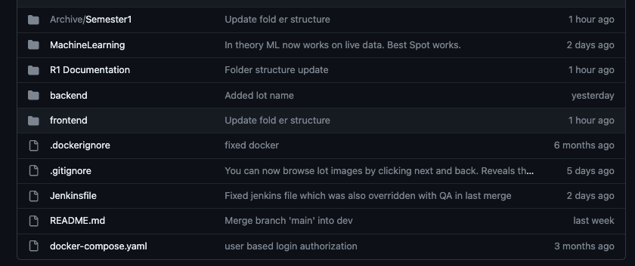
GitHub Repo structure

Slide 23
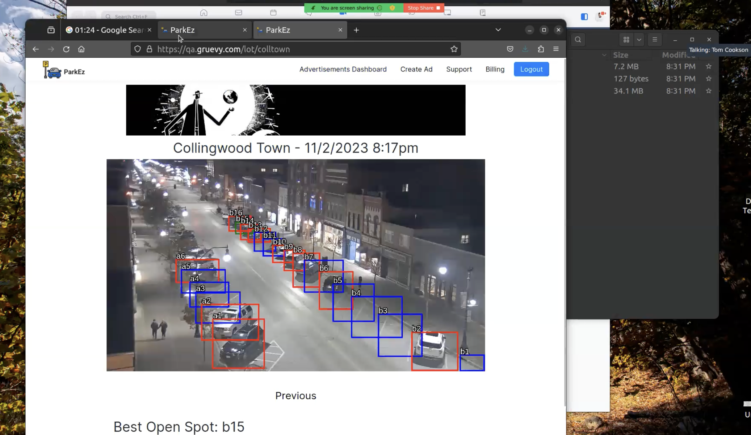
Application DEMO: Tom Cookson

